Slide 1

API Data Ingestion and Analysis
AQI (Air Quality Index) and other Air Components
https://openweathermap.org/api
David Ben Gurion

Slide 2
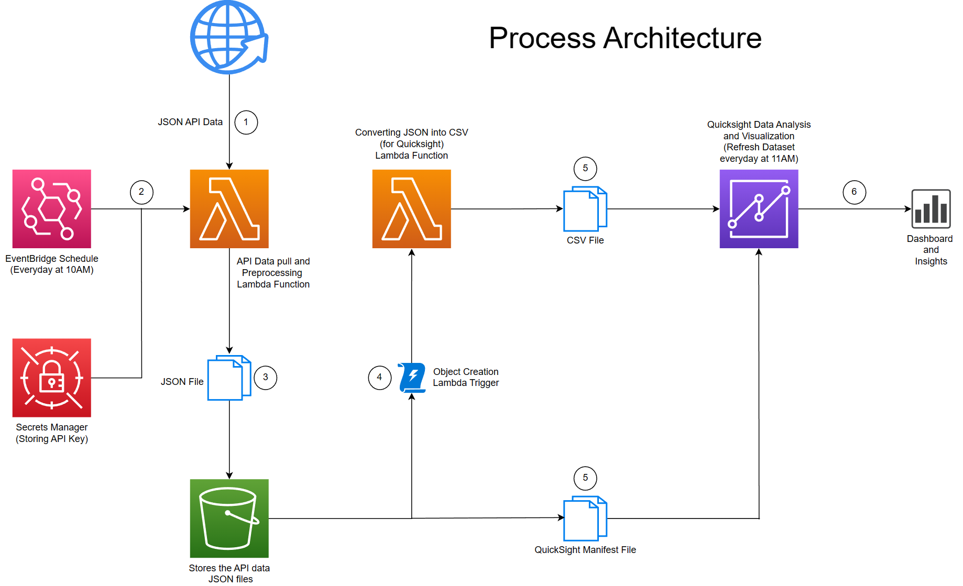

Slide 3
Process Steps:
Step 1: The API data account is set up with a secret API key.
Step 2: API endpoint URL is used with the corresponding API key stored in secrets manager by a lambda function which preprocesses the ingested data and converts it into a suitable JSON file. EventsBridge is set up along with this function for invocation daily to have the latest data.
Step 3: The output JSON file from the lambda function is stored into an S3 bucket.
Step 4: Another lambda function is set up attached with a trigger which invokes the lambda function on object creation into the previously mentioned S3 bucket. This lambda function takes in the generated API data JSON file and converts it into a processed CSV file suitable for input as a dataset for Quicksight analysis.
Step 5: The CSV file output from the second lambda function along with a JSON manifest file stored inside the mentioned S3 bucket are used to set up a dataset source for analysis with Quicksight.
Step 6: Detailed analysis and dashboards are created using Quicksight and shared.

Slide 4
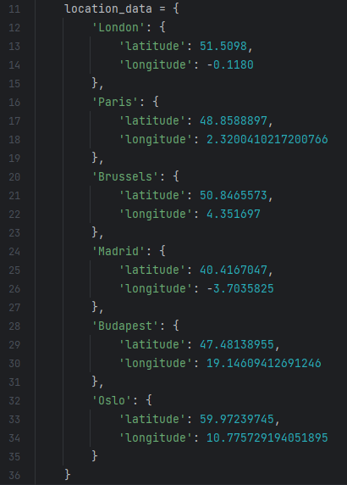
To add new data from more locations:

Slide 5
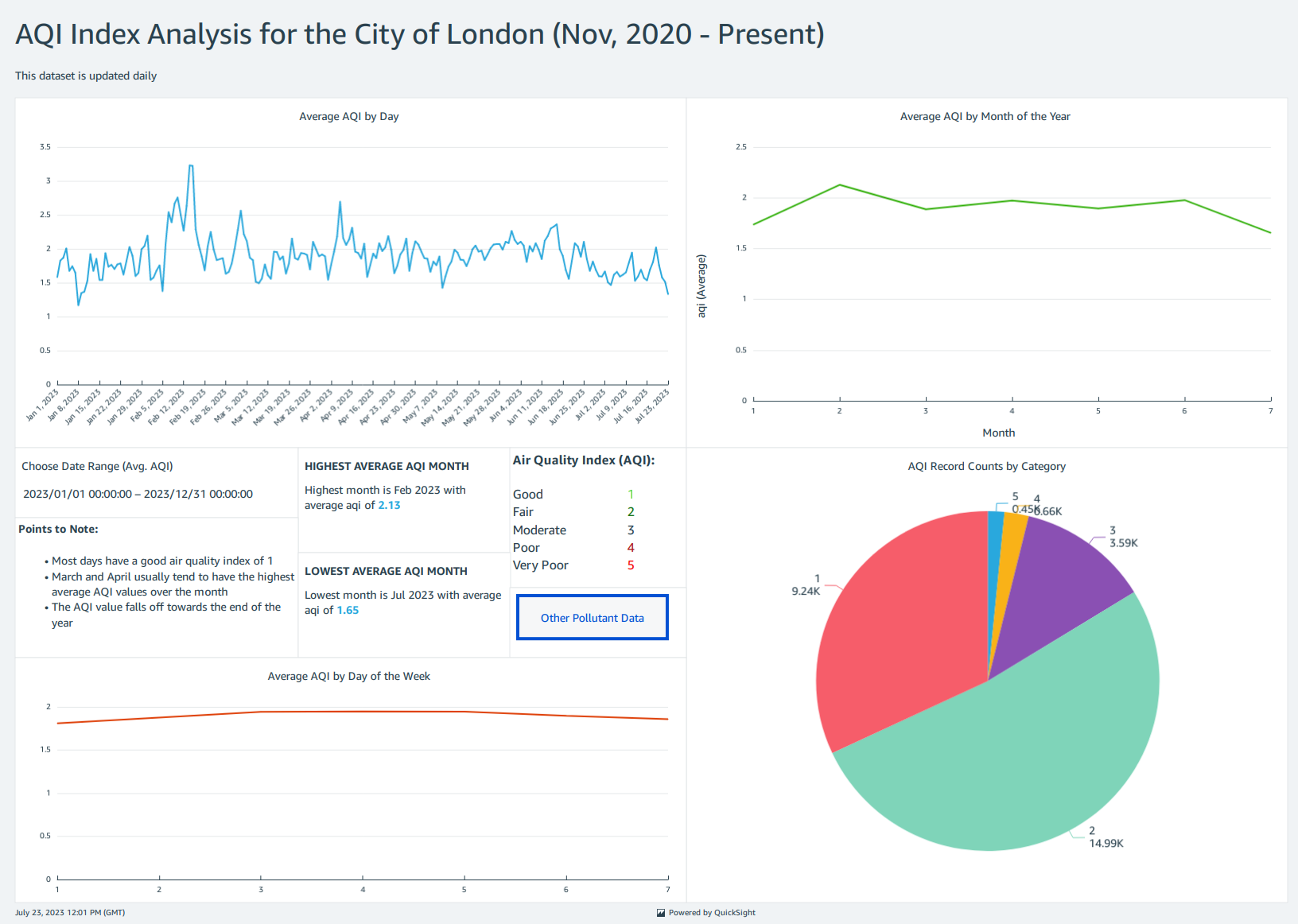
Dashboard 1

Slide 6
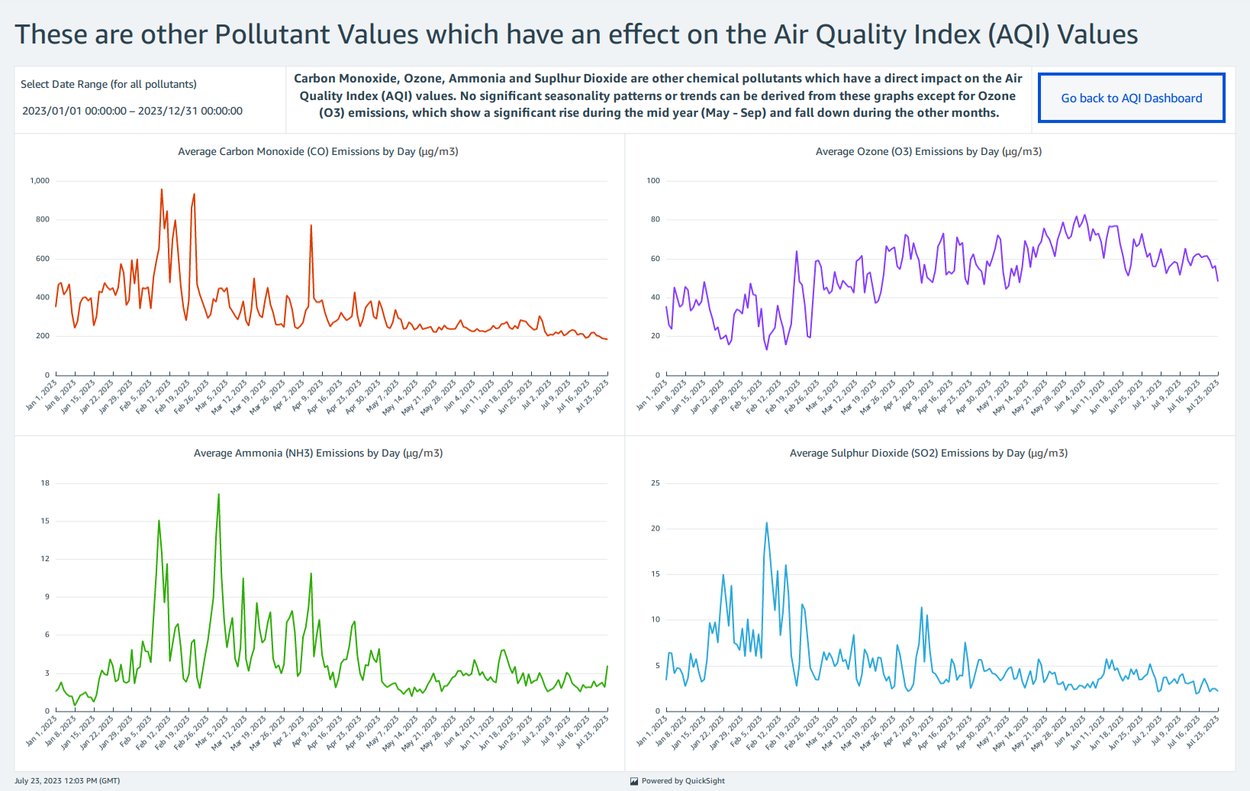
Dashboard 2

Slide 7
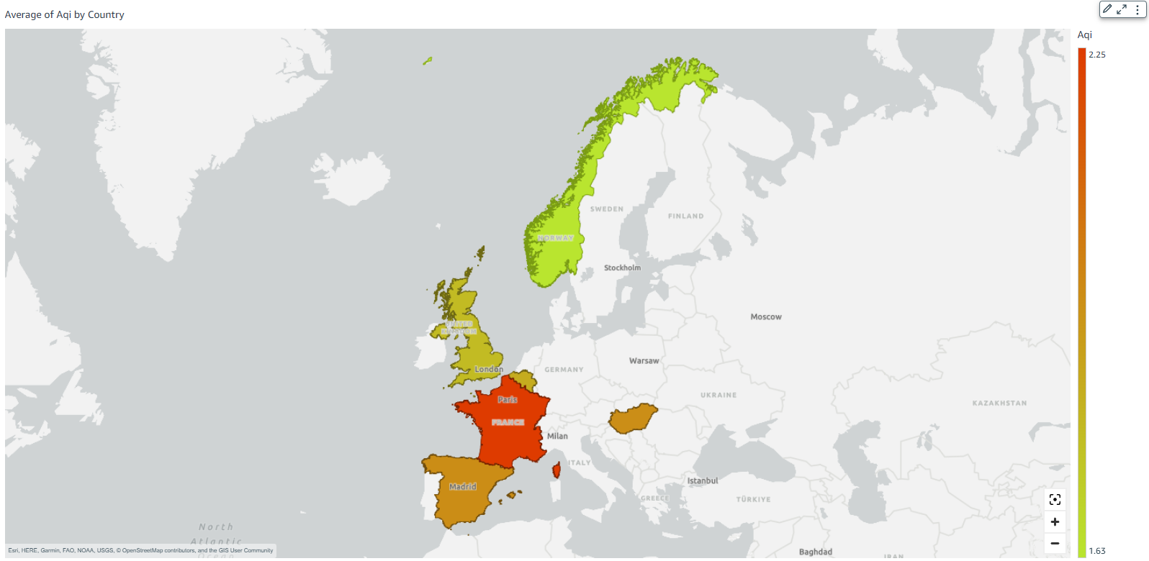
Dashboard 3

Slide 8
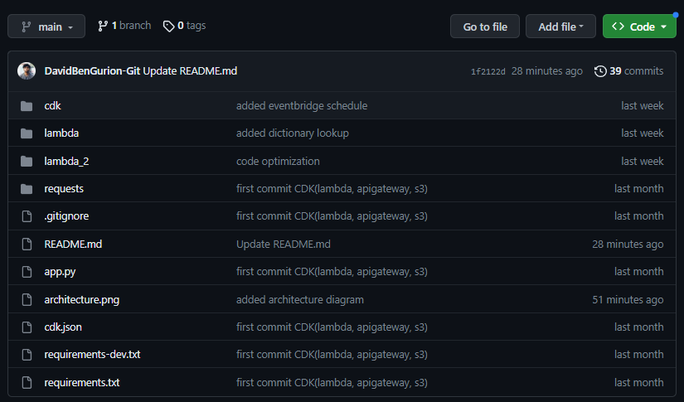
GitHub Repository
https://github.com/DavidBenGurion-Git/CDK_apiData

Slide 9
Thank you

